Slide 1
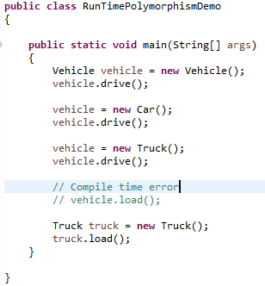
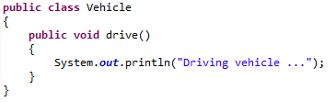
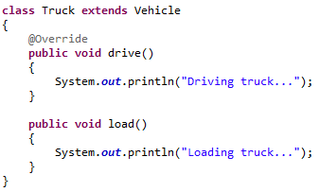
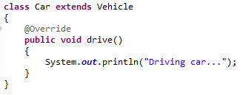
Runtime Polymorphism in Java
A Vehicle can be driven, so is a Car and Truck. But in addition to this a Truck can also be loaded with goods.

Slide 2
Runtime Polymorphism in Java
Any object declaration and instantiation has 2 parts in it: The type of the reference and the type of the object created. For example in Vehicle vehicle = new Car() the reference type is Vehicle and the object created is of type Car. Such an assignment is only possible when the object created type is a subclass of the reference type i.e. in cases where inheritance is used.
Each object reference can be used to invoke methods and the methods which can be invoked is decided based on the reference type. And this is decided during the compile time. But the implementation to be invoked is decided based on the type of the object created. In the above example: vehicle.drive() compiles because the drive() method is part of the Vehicle class and gives Driving car... as the output because the method is overridden by the Car class. On similar lines: vehicle.load() gives compile time error because the method load() is not part of the Vehicle class, but is defined only in the Truck class. But the truck.load() compiles because the reference type is Truck class and the compiler can resolve the load() method.
The method binding happens at the compile time i.e. which methods can be invoked on a given reference type is decided at the compile time.
The selection of the method’s implementation to execute happens at the run time i.e. which implementation of the method to be executed i.e. the super class version or one of the subclass’s version is decided at the run time and this is what leads to the runtime polymorphism.

